Slide 1
Text Analytics
USING R

Slide 2
Overview
Text Analytics can be used for transforming unstructured text into meaningful information for analysis.
This allows us to draw actionable insights from reviews, ratings, feedbacks etc.
These insights are usually arrived at by ignoring stop words, summarizing, ranking and scoring words by making use of different packages and other methods based on the programming language or tool of choice
In this case we have decided to use a Kaggle dataset for patient drug reviews for analysis

Slide 3
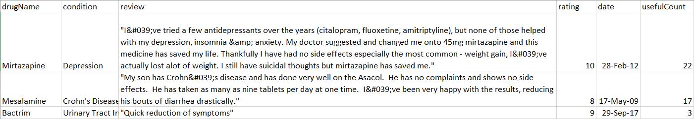
UCI Machine Learning - Drug Review Dataset
The UCI ML Drug Review dataset provides
patient reviews on specific drugs
related conditions
a 10-star patient rating system reflecting overall patient satisfaction.
Our goal:
EDA: What kind of drugs are prescribed the most? What sorts of conditions have unique drugs ? Etc.
Analyze the review text and create a sentiment score
Classify reviews on the basis of a Naive Bayes classifier
The dataset was originally published on the UCI Machine Learning repository. Citation:
Felix Gräßer, Surya Kallumadi, Hagen Malberg, and Sebastian Zaunseder. 2018. Aspect-Based Sentiment Analysis of Drug Reviews Applying Cross-Domain and Cross-Data Learning. In Proceedings of the 2018 International Conference on Digital Health (DH '18). ACM, New York, NY, USA, 121-125.

Slide 4
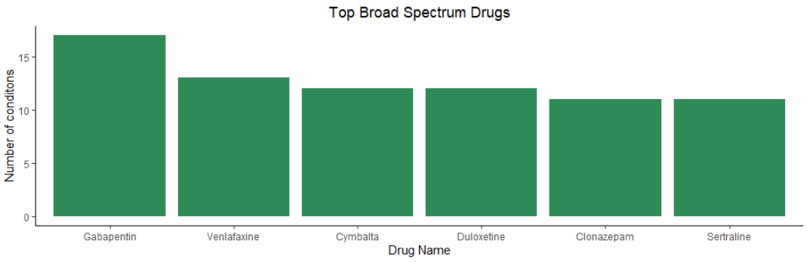
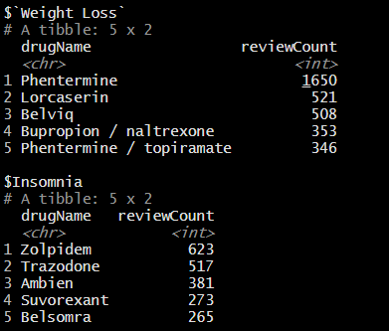
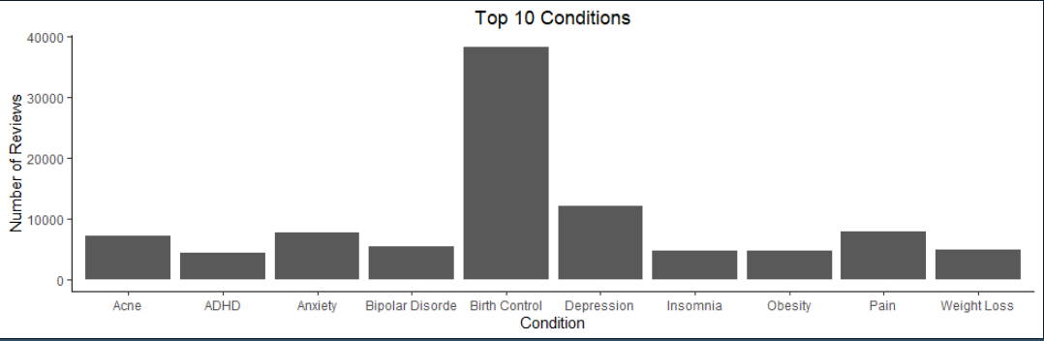
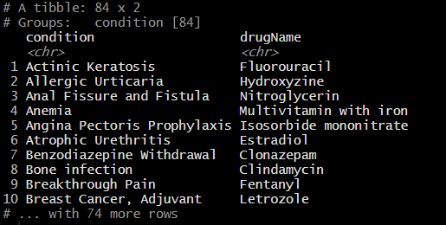
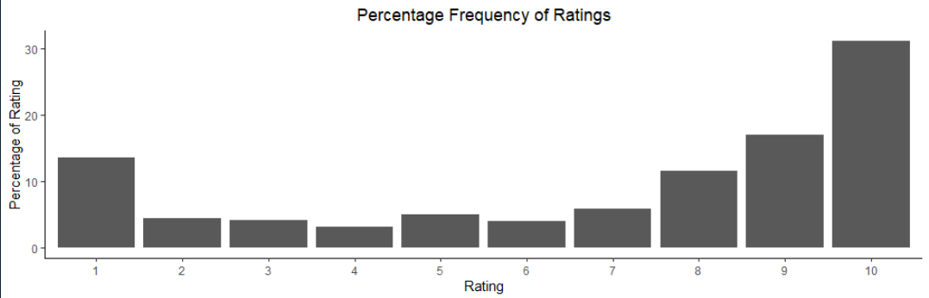
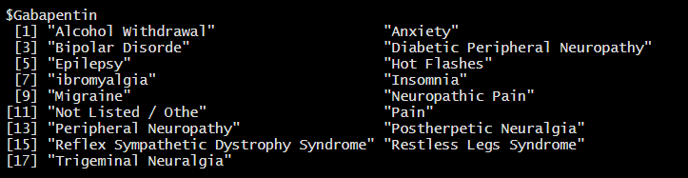
Exploratory Data Analysis (EDA)
Top 10 conditions
Top 5 drugs prescribed for the most common conditions
Broad spectrum drugs which are used for 10 or more conditions
Unique conditions with only one drug prescription
Percentage frequency of ratings

Slide 5
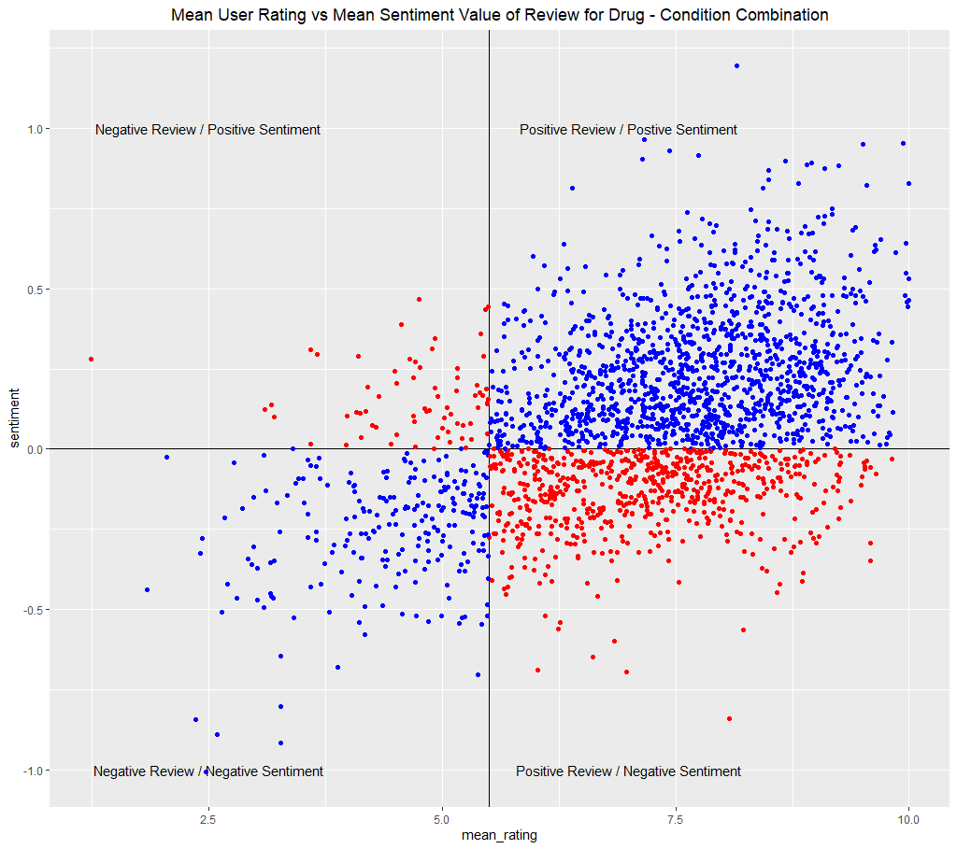
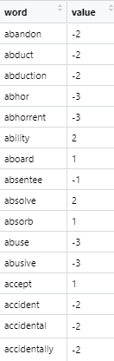
Sentiment Analysis of Reviews
“tidytext” package contains several sentiment lexicons. We have used “AFINN” and “bing” lexicons.
Assumption – Average Drug rating for a specific Condition above 5 is considered good or otherwise.
Task – Generating an average sentiment score for each drug-condition combination based on the text review.
Correlation between Average rating and Average sentiment score = 47.2%

Slide 6
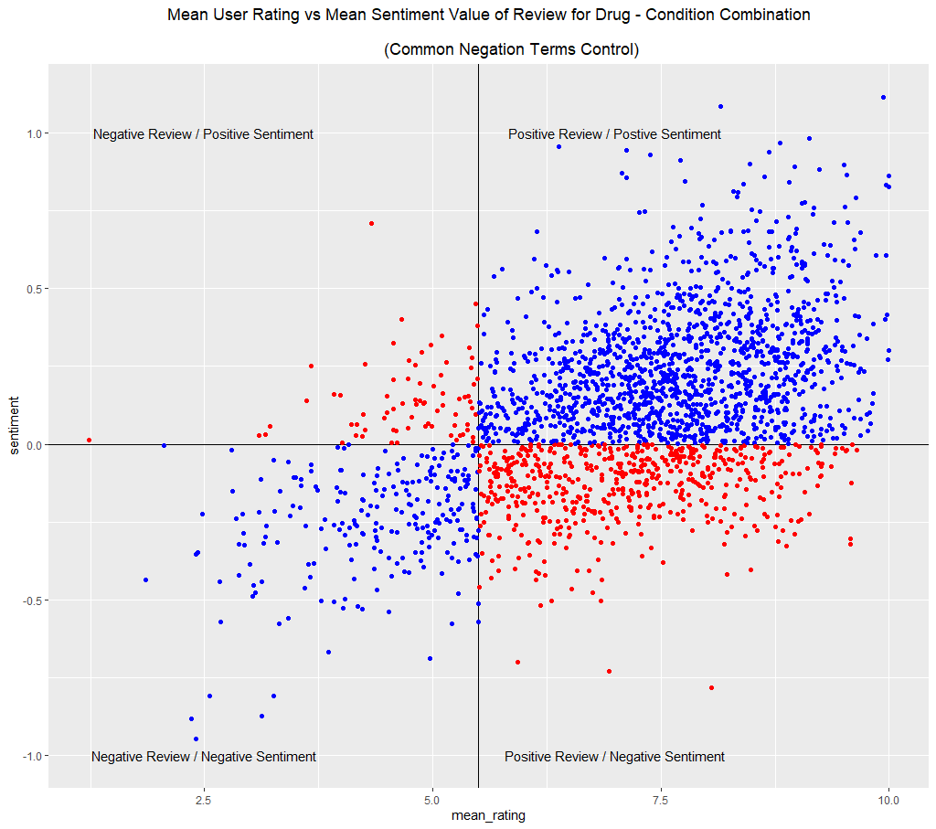
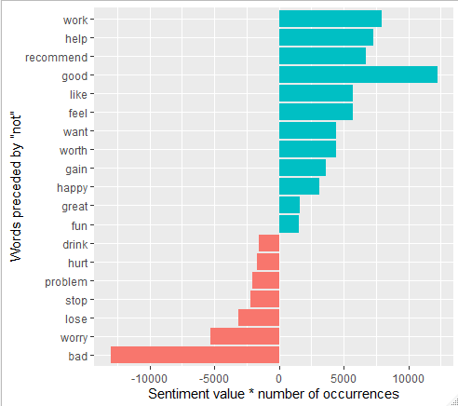
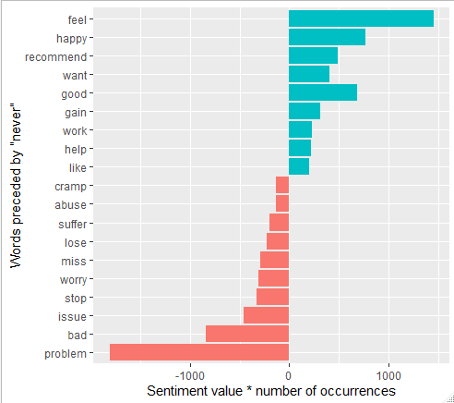
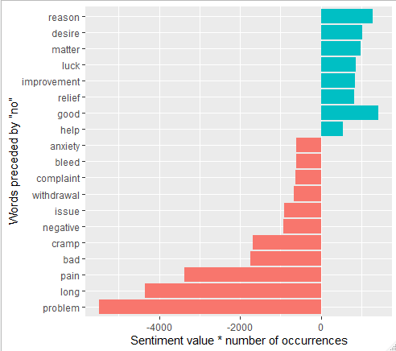
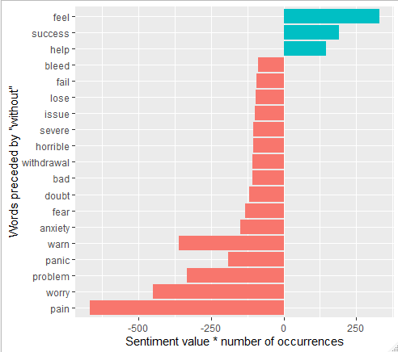
Handling Negation Terms using Bigrams
Common Negation words: No, Never, Not, Without
Correlation between Average rating and Average sentiment score increased to 50.2%

Slide 7
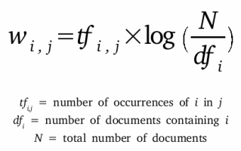
TF-IDF
TF-IDF is a weighing scheme that assigns each term in a document a weight based on its term frequency (TF) and inverse document frequency (IDF). The weight is a statistical measure used to evaluate how important a word is to a document in a collection or corpus
The importance increases proportionally to the number of times a word appears in the document but is offset by the frequency of the word in the corpus
TF- IDF Formula

Slide 8
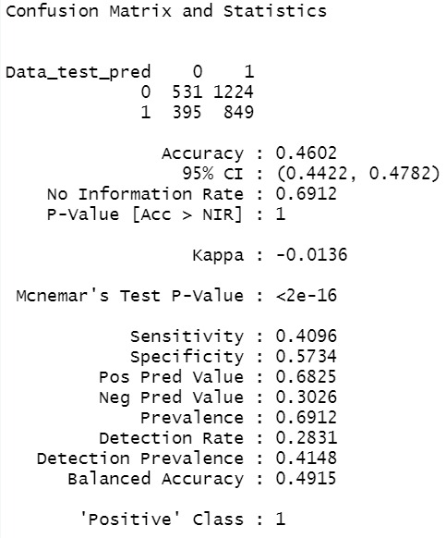
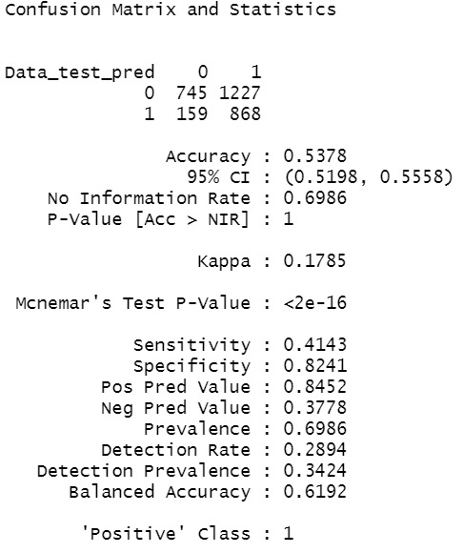
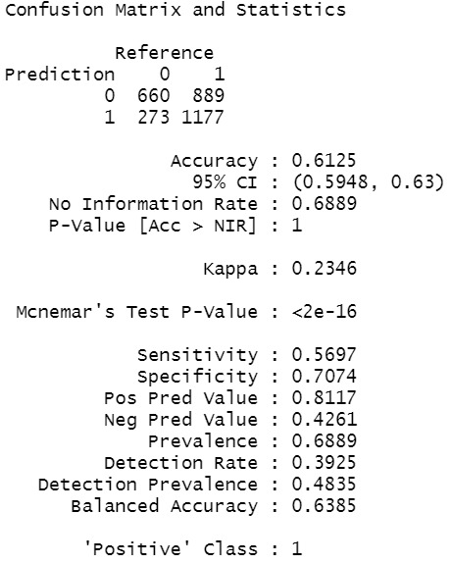
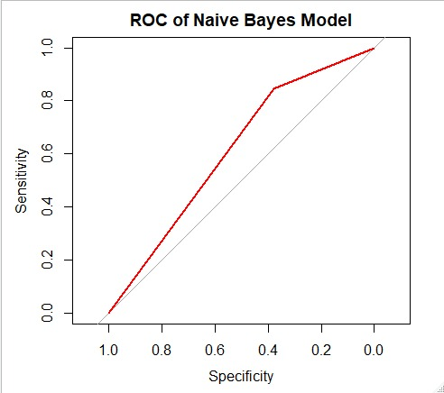
Output using Naïve Bayes
Word occurring min. 10 times and in 5 documents
Balanced Sample

Slide 9
Future Steps
1) Running more classifiers to get accuracy for our model and compare it with Naïve Bayes
2) Increasing the sample size to obtain more accurate results
3) Using N-gram with TF-IDF

Slide 10
Thank You

